Slide 1


Exercises: Organizing, Loading, and Managing Point Observations Using HydroServer
CUAHSI
HIS
Sharing hydrologic data
http://his.cuahsi.org/
Jeffery S. Horsburgh
Utah Water Research Laboratory
Utah State University
Support
EAR 0622374

Slide 2
In this Exercise
GOAL: Organize and load observational data for a continuous water quality monitoring site in the Little Bear River
Training Machine Software
Microsoft SQL Server 2008 R2 Express
CUAHSI HIS ODM Data Loader
CUAHSI HIS ODM Streaming Data Loader
CUAHSI HIS ODM Tools

Slide 3
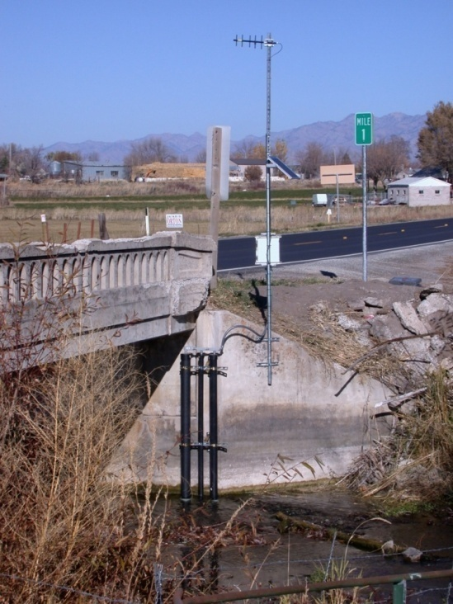
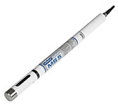
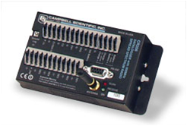

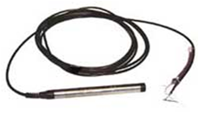
The Data You Will be Using
7 water quality and streamflow monitoring sites
Temperature
Dissolved Oxygen
pH
Specific Conductance
Turbidity
Water level/discharge
2 weather stations
Temperature
Relative Humidity
Solar radiation
Precipitation
Barometric Pressure
Wind speed and direction
Spread spectrum radio telemetry network

Slide 4
Steps
Create an ODM database
Load site, variable, method, and source information using the ODM Data Loader
Load observations using the ODM Streaming Data Loader
Visualize and explore the data using ODM Tools

Slide 5
ODM Data Loader
Loading data to any table in ODM – e.g., Sites, Variables, Methods, etc.
Loading Data Values in serial format
Multiple sites and variables in one file
All data values in a single column
Site | Variable | Date | Value
1 | Temperature | 8/2/2007 14:00 | 12.4
1 | Temperature | 8/2/2007 14:30 | 12.7
1 | Temperature | 8/2/2007 15:00 | 13.1
… | … | … | …
1 | Dissolved Oxygen | 8/2/2007 14:00 | 9.78
1 | Dissolved Oxygen | 8/2/2007 14:30 | 9.70
1 | Dissolved Oxygen | 8/2/2007 15:00 | 9.56
… | … | … | …
2 | Specific Conductance | 8/2/2007 14:00 | 351.7
2 | Specific Conductance | 8/2/2007 14:30 | 350
2 | Specific Conductance | 8/2/2007 15:00 | 351.2

Slide 6
ODM Streaming Data Loader
Focused on loading data values
Crosstab data
Single site, multiple variables
Date in one column, each variable in one column
Datalogger files from field sensors
Date | Variable_1 | Variable_2 | … | Variable_n
8/2/2007 14:00 | 13.01298 | 1.155137 | … | 9.391667
8/2/2007 14:30 | 13.222 | 1.15333 | … | 9.586666
8/2/2007 15:00 | 13.19934 | 1.153291 | … | 9.75
8/2/2007 15:30 | 13.19094 | 1.153561 | … | 9.78
8/2/2007 16:00 | 13.17751 | 1.16075 | … | 9.703334
… | … | … | … | …

Slide 7
Questions?
CUAHSI
HIS
Sharing hydrologic data
http://his.cuahsi.org/
Support
EAR 0622374

